Slide 1
Year 11 Subject Selection Final Round
Year 11 Subject Selection

Slide 2
SUBJECT SELECTION FINAL ROUND PROCESS
Emails will be sent to all students on
Monday 30 August @ 1.00pm
The email will include a link to Edval and a unique webcode
Year 11 Subject Selection

Slide 3
Online subject selection FINAL ROUND will be open
from Monday 30 August @ 1.00pm
to Wednesday 1 September @ 9.30am
The subject selection final round process will
end at 9.30am on Wednesday 1 September
Year 11 Subject Selection

Slide 4
Questions or technically issues can be directed to
Mrs Jurcevic – linda.jurcevic2@det.nsw.edu.au
Year 11 Subject Selection

Slide 5
What needs to be considered before you even enter the link
Line A | Line B | Line C | Line D | Line E | English
Biology | Biology | Ancient History | Advanced Mathematics | Business Studies | English Advanced
Community & Family Studies | Legal Studies | Biology | Standard Mathematics | Community & Family Studies
Economics | Modern History | Business Studies | Food Technology | Chemistry | English Studies
Standard Mathematics | Society and Culture | Investigating Science | PDHPE | Modern History
Music | Visual Arts | Legal Studies | Sport, Lifestyle and Recreation Studies | PDHPE | English Standard
Visual Arts | Hospitality Food & Beverage- VET | Textiles & Design | Business Services- VET | Retail Services- VET
Year 11 Subject Selection

Slide 6
Line A
Biology
Community & Family Studies
Economics
Standard Mathematics
Music
Visual Arts
Each line offers different subject combinations
Year 11 Subject Selection

Slide 7
Line B
Biology
Legal Studies
Modern History
Society and Culture
Visual Arts
Hospitality Food & Beverage- VET
Each line offers different subject combinations
Year 11 Subject Selection

Slide 8
Line C
Ancient History
Biology
Business Studies
Investigating Science
Legal Studies
Textiles & Design
Each line offers different subject combinations
Year 11 Subject Selection

Slide 9
Line D
Advanced Mathematics
Standard Mathematics
Food Technology
PDHPE
Sport, Lifestyle and Recreation Studies
Business Services- VET
Each line offers different subject combinations
Year 11 Subject Selection

Slide 10
Line E
Business Studies
Community & Family Studies
Chemistry
Modern History
PDHPE
Retail Services- VET
Each line offers different subject combinations
Year 11 Subject Selection

Slide 11
English
English Advanced
English Studies
English Standard
Each line offers different subject combinations
Year 11 Subject Selection

Slide 12
 | Line A | Line B | Line C | Line D | Line E | English
Main Units
Reserve Units
Year 11 Subject Selection

Slide 13
Line A | Line B | Line C | Line D | Line E | English
Biology | Biology | Ancient History | Advanced Mathematics | Business Studies | English Advanced
Community & Family Studies | Legal Studies | Biology | Standard Mathematics | Community & Family Studies
Economics | Modern History | Business Studies | Food Technology | Chemistry | English Studies
Standard Mathematics | Society and Culture | Investigating Science | PDHPE | Modern History
Music | Visual Arts | Legal Studies | Sport, Lifestyle and Recreation Studies | PDHPE | English Standard
Visual Arts | Hospitality Food & Beverage- VET | Textiles & Design | Business Services- VET | Retail Services- VET
Year 11 Subject Selection
 | Line A | Line B | Line C | Line D | Line E | English
Main Units
Reserve Units

Slide 14
SUBJECTS OFFERED IN ONE LINE ONLY | LINE
Economics | Line A
Music | Line A
Society and Culture | Line B
Hospitality Food and Beverage- VET | Line B
Ancient History | Line C
Investigating Science | Line C
Textiles and Design | Line C
Advanced Mathematics | Line D
Food Technology | Line D
Sport, Lifestyle and recreational Studies | Line D
Business Services- VET | Line D
Chemistry | Line E
Retail Services- VET | Line E
Year 11 Subject Selection

Slide 15
Line A | Line B | Line C | Line D | Line E | English
Biology | Biology | Ancient History | Advanced Mathematics | Business Studies | English Advanced
Community & Family Studies | Legal Studies | Biology | Standard Mathematics | Community & Family Studies
Economics | Modern History | Business Studies | Food Technology | Chemistry | English Studies
Standard Mathematics | Society and Culture | Investigating Science | PDHPE | Modern History
Music | Visual Arts | Legal Studies | Sport, Lifestyle and Recreation Studies | PDHPE | English Standard
Visual Arts | Hospitality Food & Beverage- VET | Textiles & Design | Business Services- VET | Retail Services- VET
Year 11 Subject Selection
 | Line A | Line B | Line C | Line D | Line E | English
Main Units
Reserve Units

Slide 16
Year 11 Subject Selection
On Monday, August 30, 2021,
Liverpool Girls High School <noreply@edval.education> wrote: STEP 1: Visit: https://my.edval.education/ STEP 2: Enter your web-code: ******* STEP 3: Select the subjects you want from the drop-downs, in order of your PRIORITY. STEP 4: Click [Submit].

Slide 17
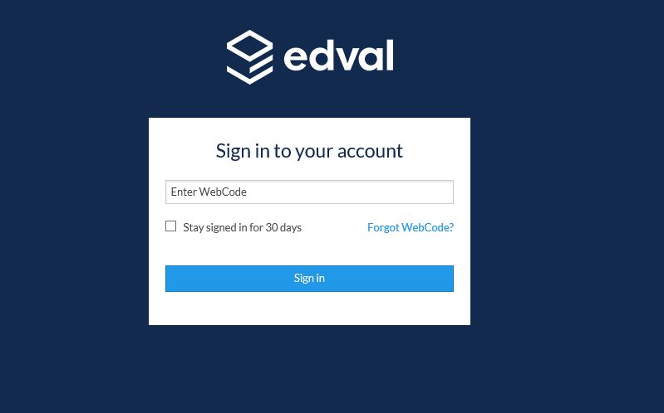
Year 11 Subject Selection
The Webcode is unique to the student and this will be emailed to all students

Slide 18
Double check this is you?
If this is not you, STOP do not proceed and contact Mrs Jurcevic
Year 11 Subject Selection

Slide 19
Year 11 Subject Selection
Click to enter

Slide 20
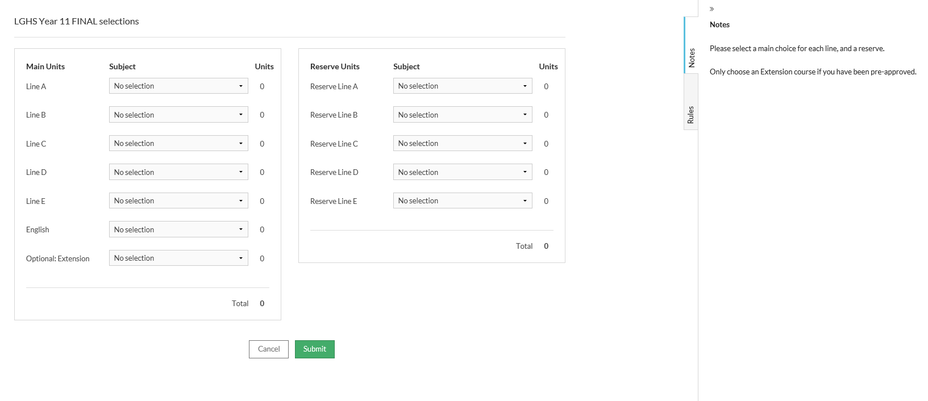
Year 11 Subject Selection
Main Units- These are the 6 subjects you really want to study
Reserve Units- These are the subjects that if you don’t get any of your 5 subjects in the “main units”, then these subjects will be used as a back up.

Slide 21
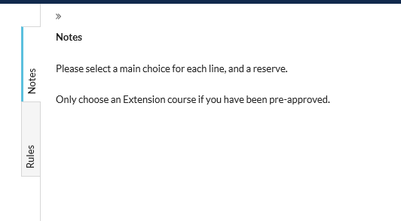
Year 11 Subject Selection
Notes- These are specific instructions

Slide 22
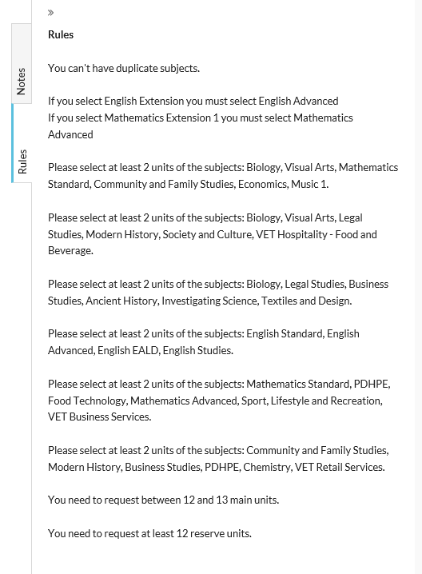
Rules- These are guidelines on what combinations of subjects you can or can’t do.
Year 11 Subject Selection

Slide 23
Line A
Biology
Community & Family Studies
Economics
Mathematics Standard
Music 1
Visual Arts
Year 11 Subject Selection

Slide 24
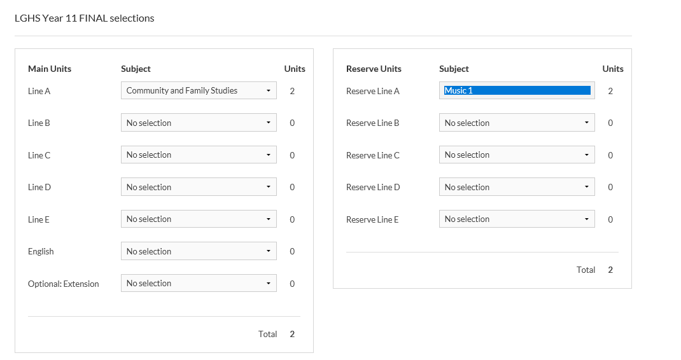
Line A
Biology
Community & Family Studies
Economics
Mathematics Standard
Music 1
Visual Arts
Year 11 Subject Selection
 | Line A
Main Units
Reserve Units

Slide 25
Year 11 Subject Selection
Main Units and Reserve units can’t be the same

Slide 26
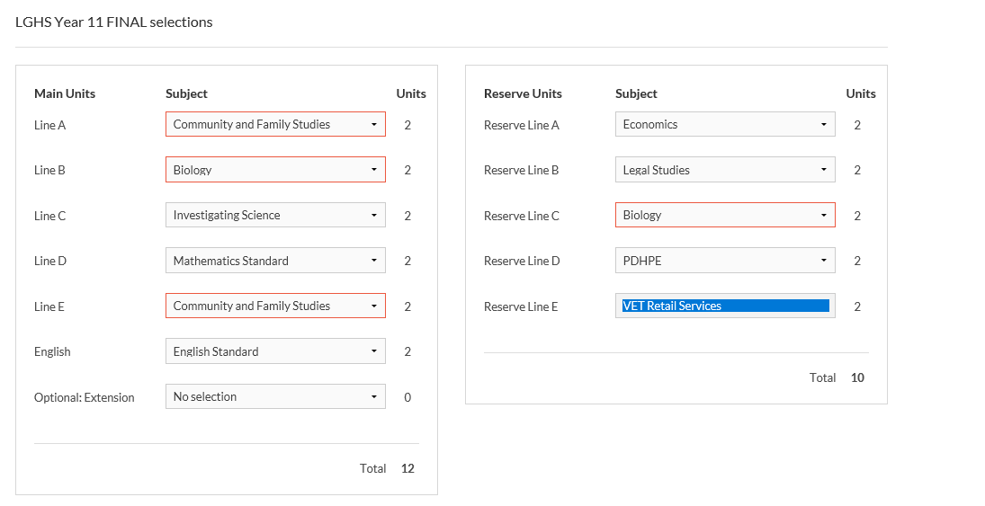
Year 11 Subject Selection
Main Units and Reserve units can’t be the same
and
Main Units can’t be the same

Slide 27
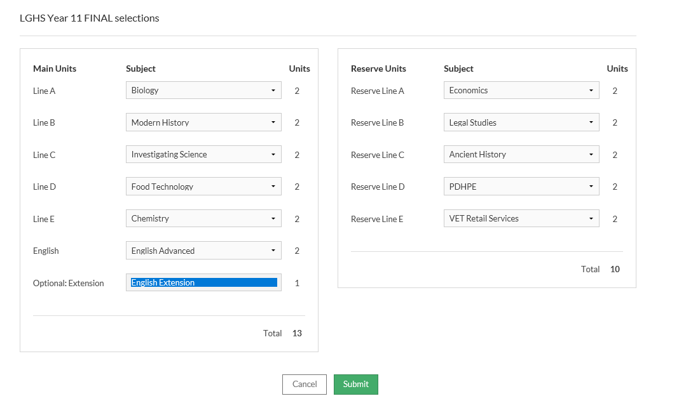
Year 11 Subject Selection
OR
The extension preference is only used if you want to study Extension Mathematics and/or Extension English.

Slide 28
If you want to do both Extension English and Extension Mathematics, you need to email Mrs Jurcevic your request
linda.jurcevic2@det.nsw.edu.au
Year 11 Subject Selection

Slide 29
Note- you can not pick the same subject
This is the screen where you need to consider your choices carefully. Once you press submit, you can’t change your choices
Year 11 Subject Selection

Slide 30
Year 11 Subject Selection
When you are happy with your choices press submit

Slide 31
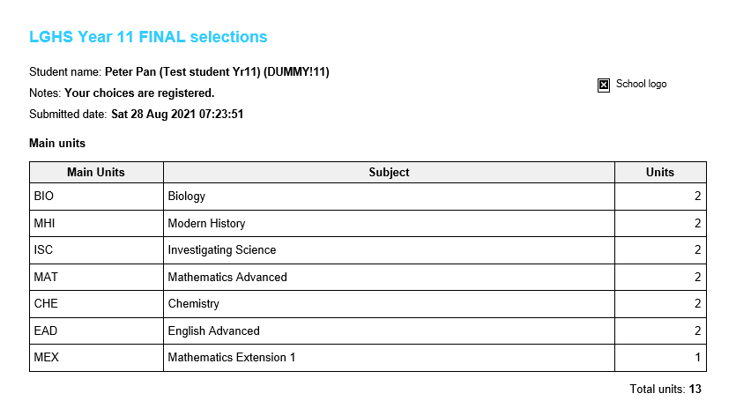
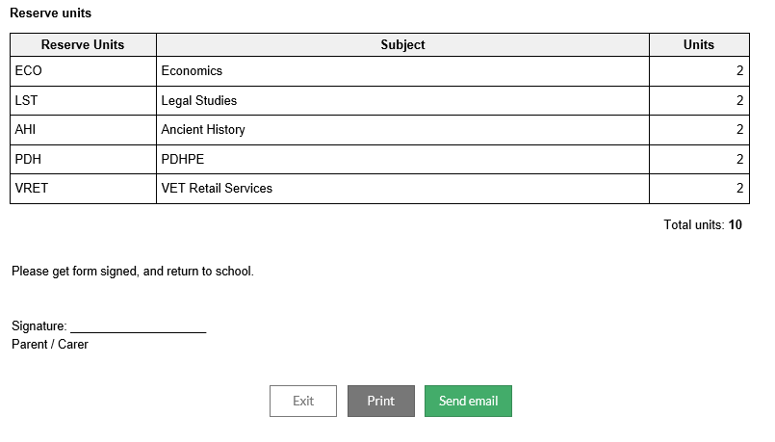
A summary page will show up, and please either print or send an email so you have a record of your choices
Year 11 Subject Selection

Slide 32
ATAR or Non-ATAR?
ALL students MUST do a level of English
To do English Extension you MUST do Advanced English
To do Mathematics Extension you MUST do Advanced Mathematics
Year 11 Subject Selection

Slide 33
If you want to do BOTH Extension English and Extension Mathematics, you MUST email Mrs Jurcevic
Year 11 Subject Selection

Slide 34
English Studies can be either an ATAR or Non ATAR course
VET Business Services, VET Hospitality- Food and Bev or VET Retail Services, can be either an ATAR or Non ATAR course
These subjects are all category B subjects. This means that no more than 2 units of Category B can count towards an ATAR.
Year 11 Subject Selection

Slide 35
English Studies
SLR*
NON ATAR
English Studies
VET Hospitality
VET Retail Services
VET Business Services
ONLY ONE will count towards and ATAR
Year 11 Subject Selection
NOTE: TWO of Category B subjects can be studied in any combination in Year 11, but IF dropping a subject it MUST be one of the above if requiring an ATAR
*SLR MUST be dropped in Year 12 if an ATAR is needed

Slide 36
English Studies
SLR
English Studies
VET Hospitality
VET Retail Services
VET Business Services
If you can’t remember the rules on choosing these subject combinations, it is advisable to talk with Mrs Jurcevic
Year 11 Subject Selection

Slide 37
Year 11 Subject Selection
Check your emails on
Monday 30 August @ 1.00pm

Slide 38
Year 11 Subject Selection
The subject selection final round process will end at 9.30am on Wednesday 1 September

Slide 39
Year 11 Subject Selection
Choose a total of 5 subjects
and a level of English the
“main units”

Slide 40
Year 11 Subject Selection
Choose CAREFULLY, once you press submit, you CAN NOT change your preferences.

Slide 41
Year 11 Subject Selection
How can I make an informed decision on what
subjects to choose?
Email your Year Advisor- Mr Dixon
anthony.dixon@det.nsw.edu.au
or
A/Year Advisor- Ms Matic
simone.vavayis@det.nsw.edu.au

Slide 42
How can I make an informed decision on what subjects to choose?
Read the Stage 6 Course Selection Handbook, 2021, and watch the Faculty Videos, which can be found on the Liverpool Girls Website
Year 11 Subject Selection

Slide 43
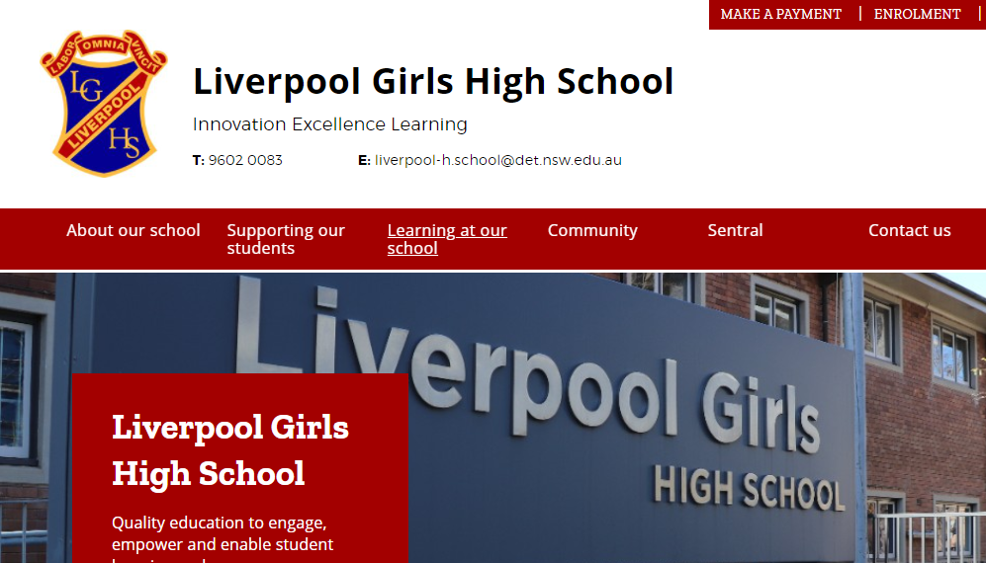
Where to find the subject selection
resources on the Liverpool Girls Website
STEP 1
Year 11 Subject Selection

Slide 44
Where to find the subject selection
resources on the Liverpool Girls Website
STEP 2
Year 11 Subject Selection

Slide 45
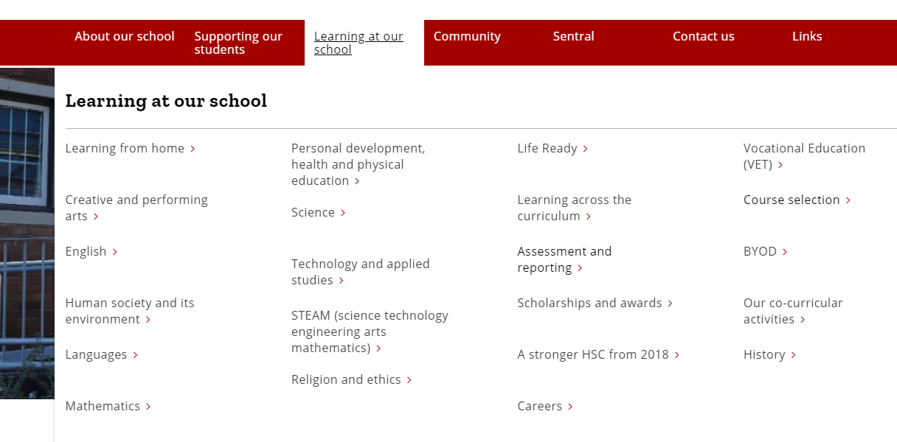
Where to find the subject selection
resources on the Liverpool Girls Website
STEP 3
Year 11 Subject Selection

Slide 46
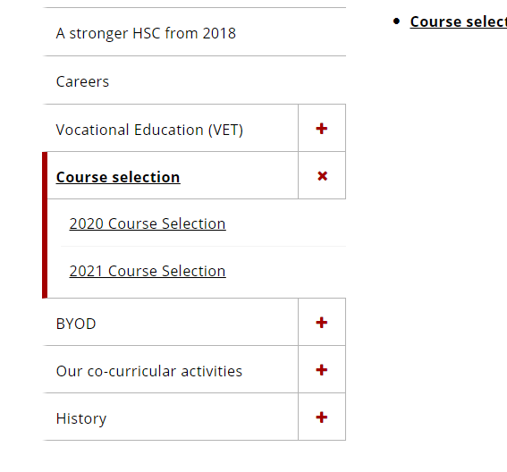
Where to find the subject selection
resources on the Liverpool Girls Website
STEP 4
Year 11 Subject Selection

Slide 47
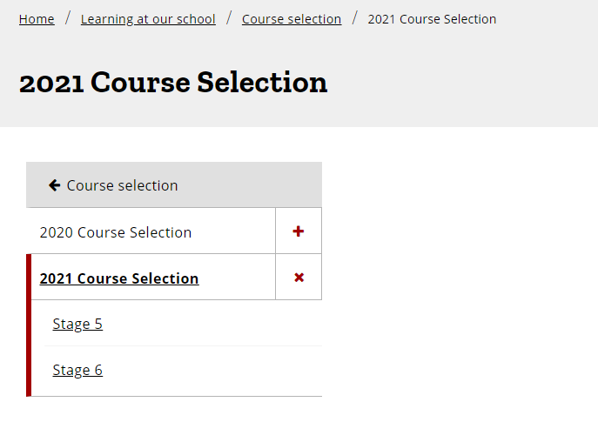
Where to find the subject selection
resources on the Liverpool Girls Website
STEP 5
Year 11 Subject Selection

Slide 48
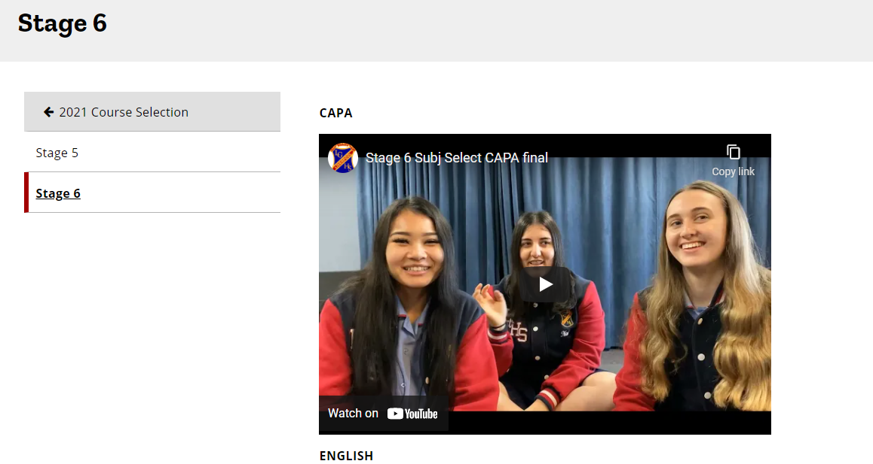
Where to find the subject selection
resources on the Liverpool Girls Website
STEP 6
All resources are found here. Don’t forget to scroll down.
Year 11 Subject Selection

Slide 49
Year 11 Subject Selection
Choose what you really want to study in Years 11 and 12.

Slide 50
Year 11 Subject Selection
This is your last opportunity to make the right choices. There will be no change of mind opportunities.

Slide 51
Year 11 Subject Selection
If you have any issues with logging on or with the webcode please email Mrs Jurcevic
linda.jurcevic2@det.nsw.edu.au

